Slide 1
ACCEPTANCE TESTING

Slide 2
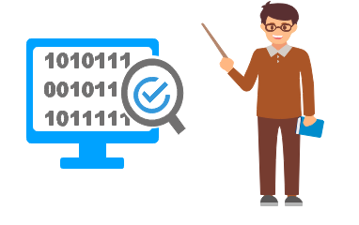
Acceptance testing is formal testing based on user requirements and function processing. It determines whether the software is conforming specified requirements and user requirements or not.
It is conducted as a kind of Black Box testing where the number of required users involved testing the acceptance level of the system.
User acceptance testing (UAT) is a type of testing, which is done by the customer before accepting the final product.

Slide 3
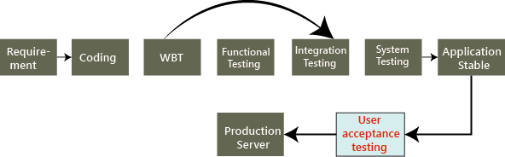
In this, we concentrate only on those features and scenarios which are regularly used by the customer
Reason behind Acceptance Testing
During the development of a project if there are changes in requirements and it may not be communicated effectively to the development team.
Developers develop functions by examining the requirement document on their own understanding and may not understand the actual requirements of the client.
There's maybe some minor errors which can be identified only when the system is used by the end.

Slide 4

Who performs user acceptance testing?
The acceptance testing can be performed by different persons in different cases.
For example, the blue-dart company gives the requirement to TCS for developing the application, and the TCS will accept the needs and agree to deliver the application in the two releases as we can see in the below image:
On August 10, the test manager tells the project manager that there is a critical bug in the application, and that will take another four days to fix it.
But the project manager said we have to deliver the software within a given time. It takes another 30 days to fix the defect, or otherwise, we will have to pay the penalty (fine) for each day after the given release date. Is this the real situation? NO, let us see three different cases and understand who perform the acceptance testing.

Slide 5
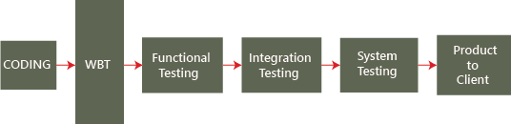
Case1
In this, test engineer will do the acceptance testing.
The blue-dart provides the requirements, and TCS develops the application and performs all the testing and handover to the blue-dart company.
Now the question arises the blue-dart will use the application as soon they get it from TCS? NO, the blue dart company has a group of test engineers after they get the software, and this team will start testing the application, and this end-to-end testing is done at the customer environment, which is called the User Acceptance Testing.

Slide 6
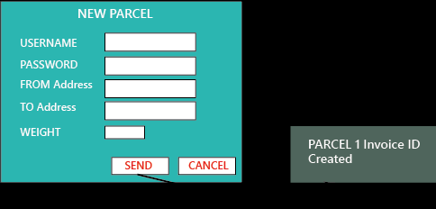
Let us see the difference between TCS test engineers and Blue-dart Engineers:
In TCS, the tester will perform the functional testing, integration testing, and system testing and whereas in Blue-dart, the tester will do only the end-to-end or system testing, which is known as acceptance testing.
The difference between end-to-end testing at TCS and blue-dart is as follows:
The blue-dart test engineer is the one who gave the requirements
The blue-dart engineer understands the product well
The blue-dart engineer is a domain expert.
They test the real-time data on the application.
To understand this, we can see the below example, or if we have the application format is like this:

Slide 7
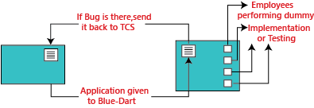
When the application is given to blue-dart test engineers, and they will perform testing and the application should generate a text message "Parcel 1 invoice Id created." It was not mentioned in the requirement, or it is there, and TCS does not fix it. Then fine(penalty) counts for TCS from that only, and whereas the test engineers at TCS will not knowing this, due to that, we can see the difference between the testing done at TCS and Blue-dart.
Case2
In this case, we will see how the Employee is becoming end-users and performing acceptance testing.
The application is developed and tested at the TCS environment and then sent to blue-dart. And in the Blue-dart, they have fewer test engineers, so they can't do acceptance testing. So for this, out of 300 employees of blue-dart, they will provide the application to the 30 employees and install the application to their systems and ask them to start using the application and find any defect or issues.

Slide 8
Now 30 employees will do the dummy implementation, which means they provide the data into the application and also written that data manually. And here, the employee becomes the end-user and also identify the bugs and issues while using the application.
If the identified bug is not as per requirement, then blue-dart can go for the Request For Enhancement [REF] and Change Request [CR].
Where Request for enhancement means that if the blue-dart feels that a particular module can be improved and developed in a better way, and then they can send the Customer Requirement Specification [CRS] as REF and TCS will follow the CRS and also make sure to do the necessary changes.
And the Change Request means, if the requirement has not been specified accurately, then blue-dart provides the exact needs and Request for changes.

Slide 9
Case3
In this case, if the blue-dart customers become the end-users.
Here, the application is developed and tested and implemented at a blue-dart production server, and n-numbers of users start using the application, which is in the first release. While using the application, the blue-dart comes up with more number of features and enhancements, which is sent with the CRS to the TCS after that TCS will do the further changes in modules and sent it back to the blue-dart.
Hence, what is happing here, the application was developed when the requirement is collected by blue-dart from their end-users and customers.
The numbers of releases depend on the following facts:
Difficulty of modules
The number of modules.
How the new module affects the old module.

Slide 10
Hotfix: In the production environment, whenever the customer identify the critical bug, we will do the following
The developers fix the bugs.
Small teams of test engineers will test the software.
Re-install the application on the client environment.
The client starts using the new software.
This entire process is known as a hotfix, and it can be done in a few hours or one day.
For example: If the significant module, suppose the Login module itself is not working at the production server, then the client will send it immediately for fixing it, and that has to be done as soon as possible.
Short release
Between two major releases, this is a short release of improvements, and it happens when the client needs some small features to change on an urgent basis.

Slide 11
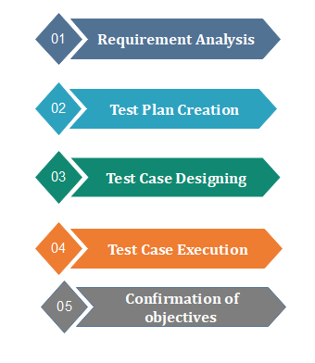
Steps to Perform Acceptance Testing

Slide 12
Tools used in Acceptance Testing
Acceptance Testing can be done by using several toolS.
Watir:
For the execution of automated browser-based test cases.
It uses Ruby language for the inter-process communication.
Fitness tool:
This tool is used to enter input values and generate test cases automatically.
The user needs to input values, these values used by the tool to execute test cases and to produce output.
It uses Java language for the inter-process communication.
This tool makes it easy to create test cases as well as record them in the form of a table.

Slide 13
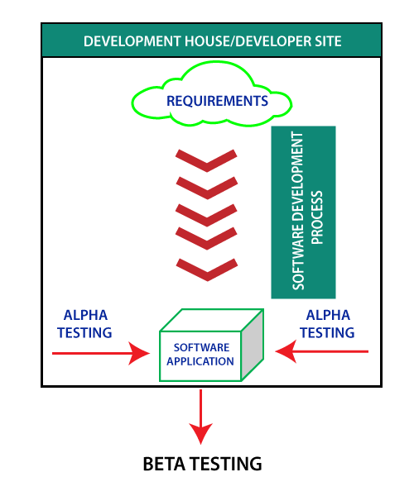
Alpha Testing
Alpha testing is conducted in the organization and tested by a representative group of end-users at the developer's side and sometimes by an independent team of testers.
Alpha testing is simulated or real operational testing at an in-house site. It comes after the unit testing, integration testing, etc. Alpha testing used after all the testing are executed.
It can be a white box, or Black-box testing depends on the requirements - particular lab environment and simulation of the actual environment required for this testing.

Slide 14
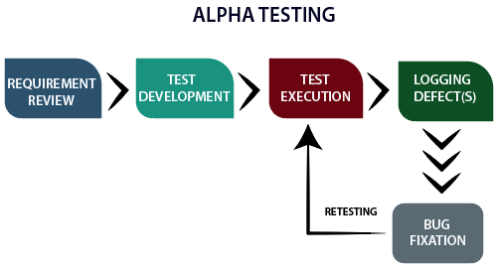
What is the alpha testing process?
Requirement Review: Review the design of the specification and functional requirement
Test Development: Test development is base on the outcome of the requirement review. Develop the test cases and test plan.
Test case design: Execute the test plan and test cases.
Logging Defects: Logging the identified and detected bug found in the application.
Bug Fixation: When all the bugs are identified and logged, then there is a need to fix the bug.
Retesting: When all the issues are solved, and fixed retesting is done.

Slide 15
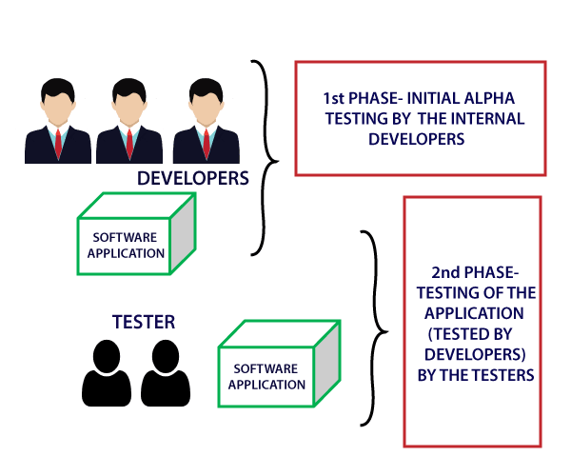
What are the phases of alpha testing?
There are two phases of alpha testing.
First Phase: In-house developers of software engineers do the first phase of testing. In this phase, the tester used hardware debugger or hardware aided debugger to catches the bugs quickly. During the alpha testing, a tester finds a lot of bugs, crashes, missing features, and docs.
Second Phase: The second phase involves the quality assurance staff performs the alpha testing by involving black box and white box techniques.

Slide 16
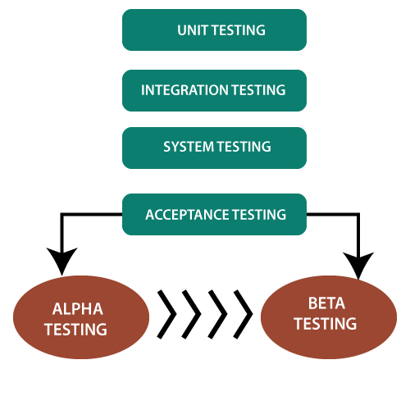
When to perform alpha testing?
Alpha testing is user acceptance testing.
Alpha testing performed once the product has gone through stages of testing and prepared for release.
It is executing before beta testing, which is also a part of acceptance testing and can define as field testing. During this testing, we can make changes in the software to improve its quality and functionality.
Alpha testing done from the developer's site where independent developers can monitor and record user experience and make necessary changes to enhance the performance.

Slide 17
What are the reasons to perform Alpha Testing?
Refines the software product by finding and rectifying bugs that weren't discovered through previous tests.
Alpha testing allows the team to test the software in a real-world environment.
One of the reasons to do alpha testing is to ensure the success of the software product.
Alpha testing validates the quality, functionality of the software, and effectiveness of the software before it released in the real world.
What are the advantages of Alpha Testing?
Reduces the delivery time of the project.
It provides a complete test plan and test cases.
Free the team member for another project.
Every feedback helps to improve software quality.
Better observation of the software's reliability and accountability

Slide 18
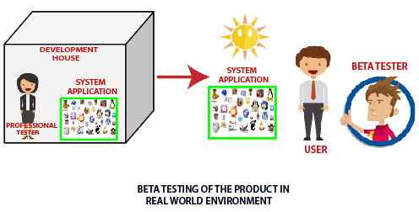
What is Beta Testing?
Beta testing is a type of User Acceptance Testing among the most crucial testing, which performed before the release of the software.
Beta Testing is a type of Field Test.
This testing performs at the end of the software testing life cycle. This type of testing can be considered as external user acceptance testing.
Real users perform this testing. This testing executed after the alpha testing. In this the new version, beta testing is released to a limited audience to check the accessibility, usability, and functionality, and more.

Slide 19
What are the features of beta testing?
Beta testing used in a real environment at the user's site. Beta testing helps in providing the actual position of the quality.
Testing performed by the client, stakeholder, and end-user.
Beta testing always is done after the alpha testing, and before releasing it into the market.
Beta testing is black-box testing.
Beta testing performs in the absence of tester and the presence of real users.
Beta testing generally is done for testing software products like utilities, operating systems, and applications, etc.

Slide 20

What is a beta version of the software?
Closed beta version:
Closed beta version, also known as a private beta, it is released to a group of selected and invited people.
Those people will test the software and evaluate their features and specifications.
This beta version represents the software which is capable of delivering value, but it is not ready to be used by everyone. Because it shows the issues like lack of documentation or missing vital features.

Slide 21
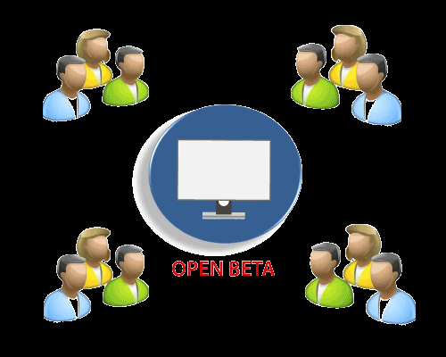
Open beta version:
Open beta is also known as a public beta.
The open beta opened to the public.
Any user as a tester can assess the beta version to provide the relevant feedback and reviews.
Open beta version improves the quality of the final release. This version helps to find the various undetected errors and issues.

Slide 22
What is the lifecycle of Beta Testing?
Planning: Like another testing process, beta testing also supports proper planning. In this stage, the team prepares a testing strategy and defines the goal of testing.
Participant Recruitment: In which the team recruits a group of selected end-users for testing. This group can change as per the requirement of the organization and the product.
Product Launch: When a team of users (testers) recruited. The beta version of the product is launched or installed at the client or user side, and users will test the product for quality assurance.
Collect and Evaluate Feedback: When the testing finished, developers will collect the feedback provided by the testers and evaluate it. In the end, based on the feedback, issues, and bugs are fixed and resolved by the responsible individual team.
Closure: When all the problems fixed and the organization meets the exit criteria, beta testing achieved, and the rewards offered to the testing team.

Slide 23
types of beta testing?
Open Beta Testing: Open beta testing involves testing the software product by a large number of people before the final release. The organization decides to make a software product open to the public before releasing the product.
Closed Beta Testing: Opposite to the open beta testing. Closed beta testing performed by the selective and limited number of persons.
Traditional Beta Testing: In this testing, a software product delivered to the target market, and the feedback from the users collected. This type of testing assistance the beta testing, the quality of the software is improved, and developers can make the changes.
Public Beta Testing: This type of testing is similar to open testing. Public beta testing also allows the product is delivering to the end-users worldwide, with the aid of various online channels available in the world. From this, the feedback and evaluated data also collected and based on the requirement changes, and the development team implements modifications.
Technical Beta Testing: This testing involves delivering the software product to the internal groups of the organization. However, the data and feedback provided by the employees of the organization.
Focused Beta Testing: This type of testing focused on monitoring and evaluating a specific feature or component of the software. In focused beta testing, the software released to the market and user's experience assessed and collected to make the required changes.
Post-Release Beta Testing: In this testing, the product delivered to the market for the use of the end-users. Their feedback, reactions, and experience are collect for the future release of the software.

Slide 24
When to perform Beta Testing?
All the component of the product is ready to start this testing.
Documentation which is going to end-user should be kept ready - Setup, installation, usage, Uninstallation should be in detail.
The product management team should review that all the functionality is in good condition.
Procedure to collect bugs, feedback, etc. should be identified before publishing it.
What are the entry criteria for Beta Testing?
Sign off the document from alpha testing.
Beta version of the software should ready.
The environment should be ready to release the software application to the public.
To capture the real-time faults environment should be ready.
What are the exit criteria for Beta Testing?
All the major and minor issues resolved.
The feedback report should prepare.
The delivery of beta test summary report.

